Slide 1


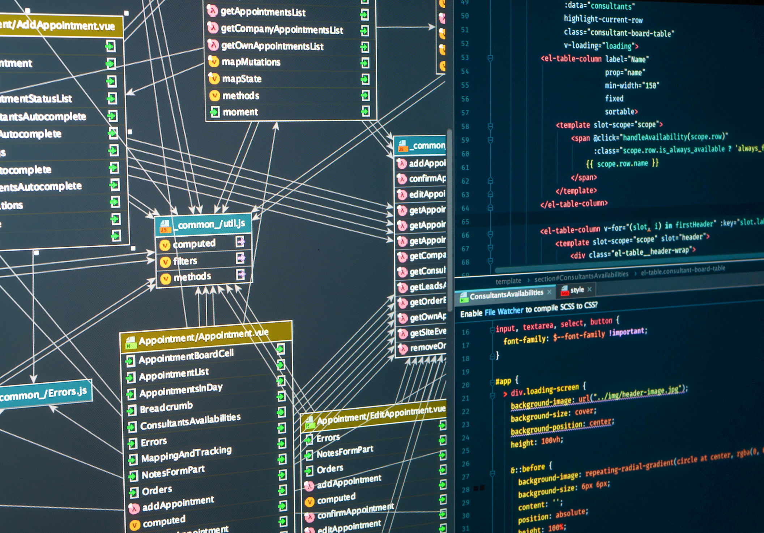
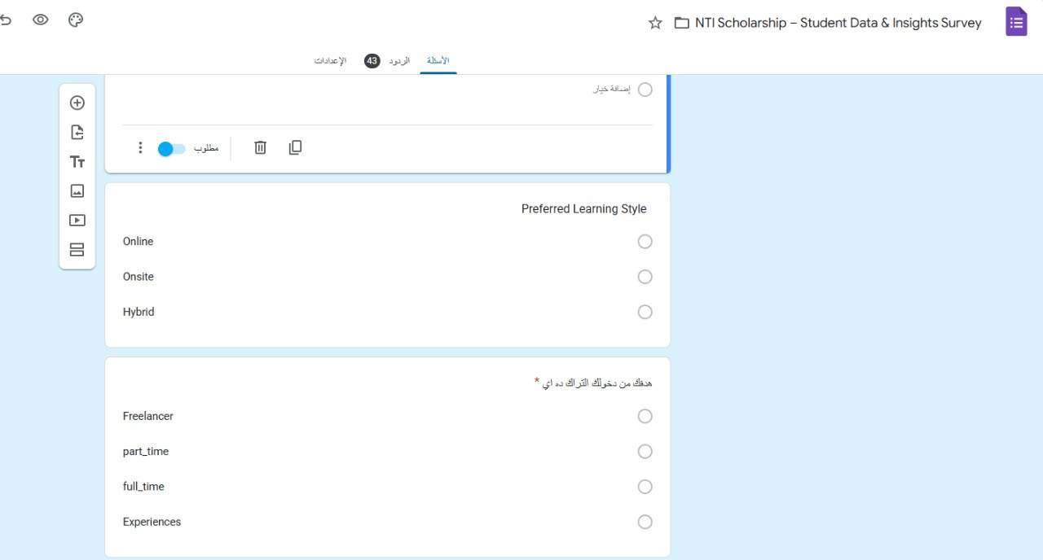

NTI Scholarship Database
FROM AN IDEA, TO A SURVEY, TO A STORY TOLD BY DATA

Slide 2

Why this project?
Goal: Build a database from scratch + extract valuable insights
Collected data from a survey with 42 participants.

Slide 3

Main tables:
Person: personal information.
Education: faculty, graduation year, GPA.
Track: scholarship tracks.
Expectation: applicants’ goals & track choice.
Application_Status: application progress.
Skills + Person_Skills: applicants’ skills.
Feedback: ratings & comments.

Slide 4


Data Cleaning
Converted GraduationYear from text → numeric.
Dropped temporary tables (Person11, Education11…).
Adjusted data types for consistency.

Slide 5







some Queries
AVERAGE AGE OF APPLICANTS.
GENDER DISTRIBUTION (MALE VS. FEMALE).
HIGHEST GPA AND TOP STUDENTS.
MOST POPULAR TRACK CHOSEN.
ACCEPTED STUDENTS WITH HIGH GPA.
APPLICANTS’ GOALS

Slide 6
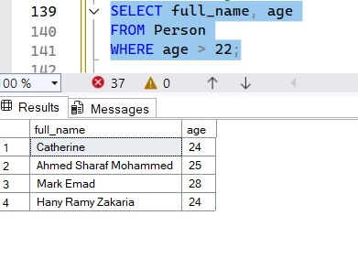
How are the people older than ?
SELECT full_name, age
FROM Person
WHERE age > 22;

Slide 7
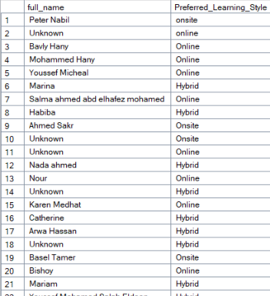
What are the names of the people and their preferred learning style?
SELECT full_name,
Preferred_Learning_Style
FROM Person;

Slide 8
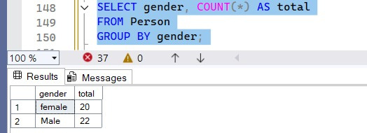
What is the number of females compared to males?
SELECT gender, COUNT(*) AS total
FROM Person
GROUP BY gender;

Slide 9
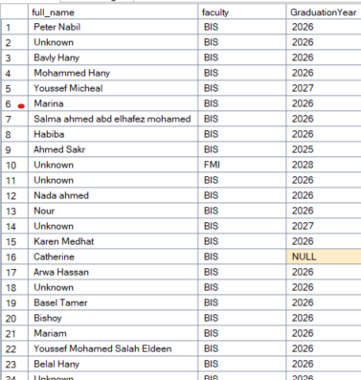
What is each person’s faculty and expected graduation year?
SELECT p.full_name, e.faculty, e.GraduationYear
FROM Education e
JOIN Person p
ON e.person_id = p.person_id;

Slide 10
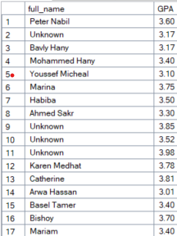
What is each person’s GPA?
SELECT p.full_name, e.GPA
FROM Education e
JOIN Person p
ON e.person_id = p.person_id
WHERE e.GPA > 3.0;

Slide 11
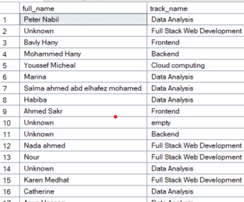
Which track did each person choose?
SELECT p.full_name, t.track_name
FROM Expectation ex
JOIN Person p ON ex.person_id = p.person_id
JOIN Track t
ON ex.track_id = t.track_id;

Slide 12
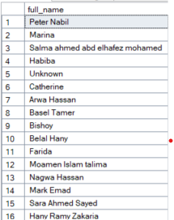
Who are the people that chose the Data Analysis track?
SELECT p.full_name
FROM Expectation ex
JOIN Person p
ON ex.person_id = p.person_id
JOIN Track t
ON ex.track_id = t.track_id
WHERE
t.track_name =
'Data Analysis';

Slide 13
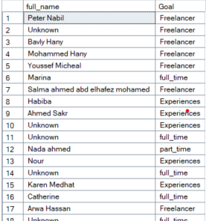
What is each applicant’s goal for applying to the scholarship?
SELECT p.full_name, ex.Goal
FROM Expectation ex
JOIN Person p
ON ex.person_id = p.person_id

Slide 14
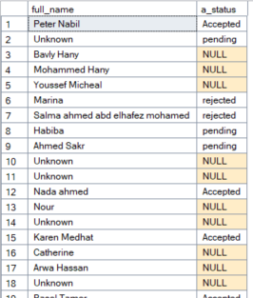
What is each applicant’s application status?
SELECT p.full_name, a.a_status
FROM Application_Status a
JOIN Person p
ON a.person_id = p.person_id;

Slide 15
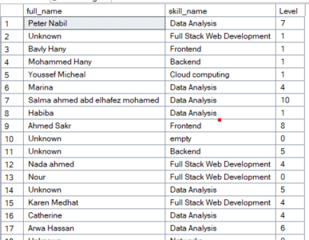
What skills does each applicant have, and what is their proficiency level (%)
SELECT p.full_name, a.a_status
SELECT p.full_name, s.skill_name, ps.Level
FROM Person_Skills ps
JOIN Person p
ON ps.person_id = p.person_id
JOIN Skills s
ON ps.skill_id = s.skill_id;

Slide 16
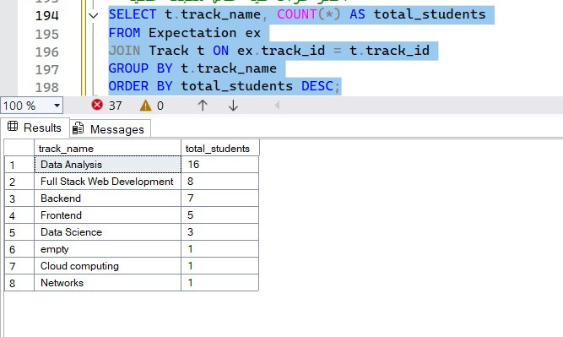
Which track has the highest number of applicants?
SELECT t.track_name, COUNT(*) AS total_students
FROM Expectation ex
JOIN Track t ON ex.track_id = t.track_id
GROUP BY t.track_name
ORDER BY total_students DESC;

Slide 17
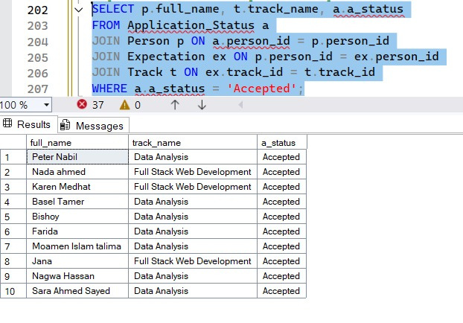
What are the names of the accepted applicants and which track were they accepted into?
SELECT p.full_name, t.track_name, a.a_status
FROM Application_Status a
JOIN Person p ON a.person_id = p.person_id
JOIN Expectation ex ON p.person_id = ex.person_id
JOIN Track t ON ex.track_id = t.track_id
WHERE a.a_status = 'Accepted';

Slide 18
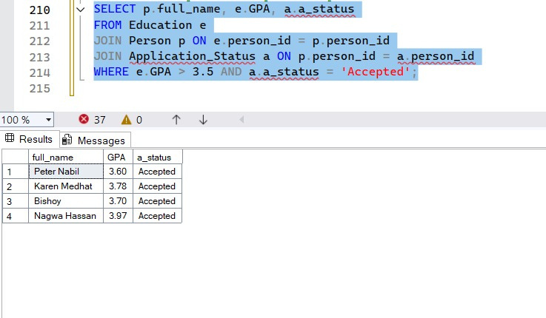
What are the names of the accepted applicants who also have a high GPA?
SELECT p.full_name, e.GPA, a.a_status
FROM Education e
JOIN Person p ON e.person_id = p.person_id
JOIN Application_Status a ON p.person_id = a.person_id
WHERE e.GPA > 3.5 AND a.a_status = 'Accepted';

Slide 19

Reflection
Learned how to design a database from scratch.
Dealt with real, imperfect data (cleaning, type conversion).
Practiced turning SQL queries into a clear story.

Slide 20


Final Outcome
A COMPLETE DATABASE BUILT FROM SCRATCH.
REAL SURVEY DATA
(42 PARTICIPANTS).
CLEANED, ORGANIZED, AND ANALYZED.
INSIGHTS COMMUNICATED AS A DATA STORY.

Slide 21

"This project showed me how even small datasets can tell powerful stories, drive insights, and support smarter decisions."

Slide 22
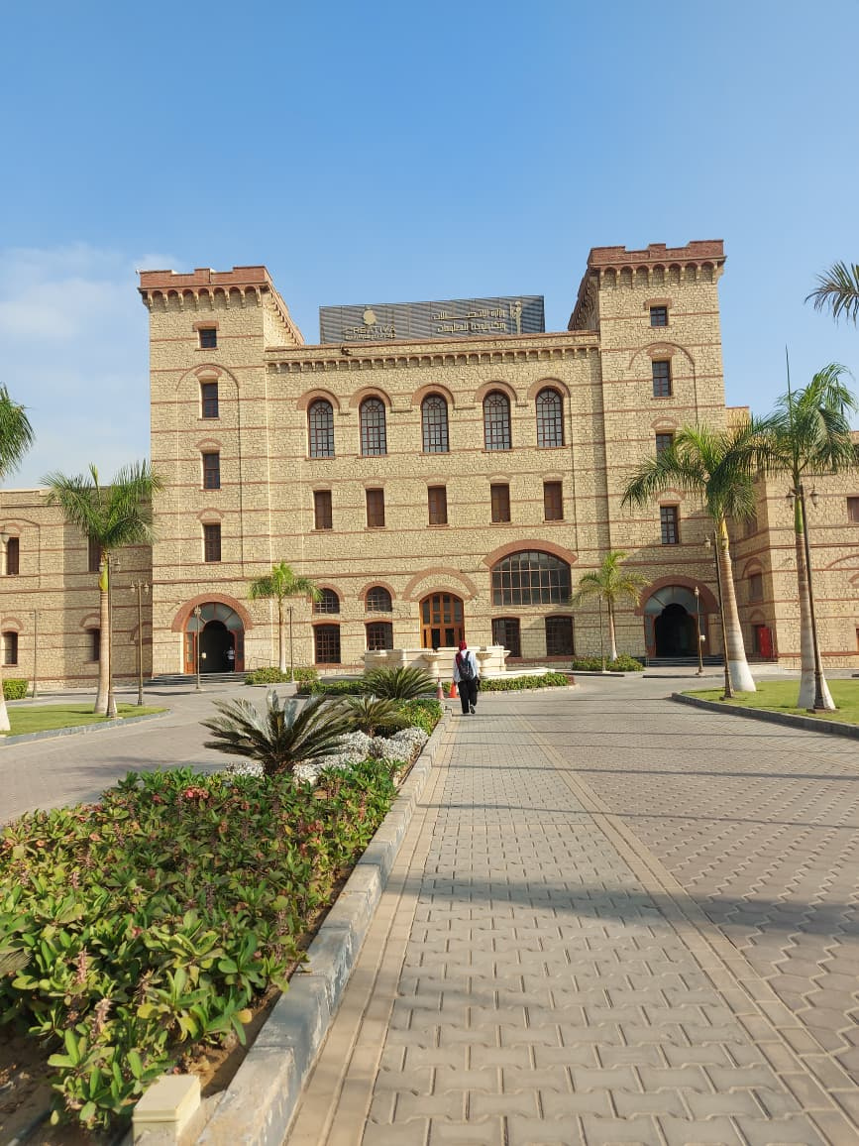

Thank You B1.101

